Slide 1
Engineering Cycle Worksheet
Jad Isidore
2021101043

Slide 2
1 DECOMPOSE the problem
What is the problem you are solving? What smaller problems can you break it into?
Big Goal:
Print “Even” or “Odd” for any number entered by a user.
User should be allowed to enter any number on four separate occasions.
Subgoals:
If that number, when divided by 2, has a remainder, output “Odd”
If that number, when divided by 2, has no remainder, output “Even”

Slide 3
1 DECOMPOSE the problem
Based on your understanding of the problem, make an educated guess about which coding concepts you will use.
Coding concepts:
I believe that I may have to use conditional statements, variables and for loops in this lab.

Slide 4
2 PLAN a solution
How should your algorithm solve the problem? Plan your solution in plain English or pseudocode.
First, I have to…
Establish all my variables.
Then I have to…
Formulate conditionals; the results if the number has a remainder or if it does not have a remainder.

Slide 5
2 PLAN a solution
How should your algorithm solve the problem? Plan your solution in plain English or pseudocode.
Finally, I have to…
Ensure that the user can see whether number entered is odd or even.

Slide 6
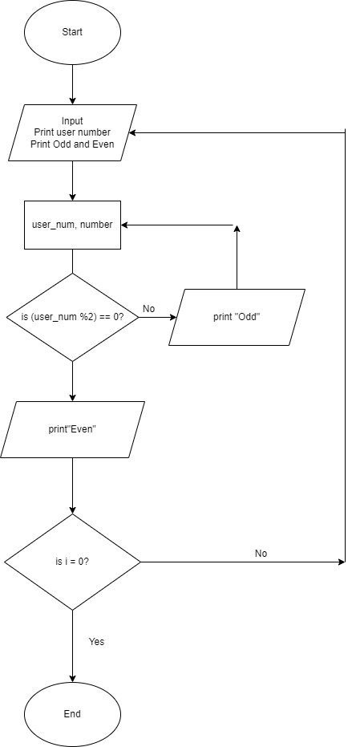
2 PLAN a solution

Slide 7
2 PLAN a solution
IPO Chart
INPUT | PROCESS | OUTPUT
user_num | if user_num %2 == 0 = print Even | Even
countdown | if user_num %2 !=0 print Odd | Odd
Odd, Even | i - 1

Slide 8
3 IMPLEMENT the solution
# To determine whether a hnumber is odd or even
# Using conditionals to meet particular results
i = 4
for i in range (0,4):
user_num = int(input("Enter your number: "))
if (user_num % 2) == 0:
print("{0} is an Even number".format(user_num))
else:
print("{0} is an Odd number".format(user_num))
i = i - 1

Slide 9
4 TEST and DEBUG the code
Type your code into the code editor. Hit “run” to see if your code does what you intended. Make sure to check your spelling, syntax and structure. Type ‘x’ for which happens, add additional where applies.
X | Code works as intended
X | Everything is spelled correctly
X | Lines are properly indented
X | Parentheses () are correct
X | Capitalization is correct
X | Variables are defined before I use them

Slide 10
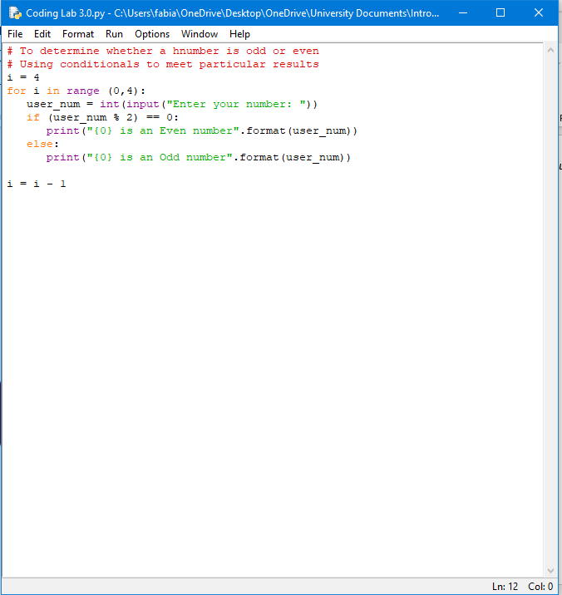
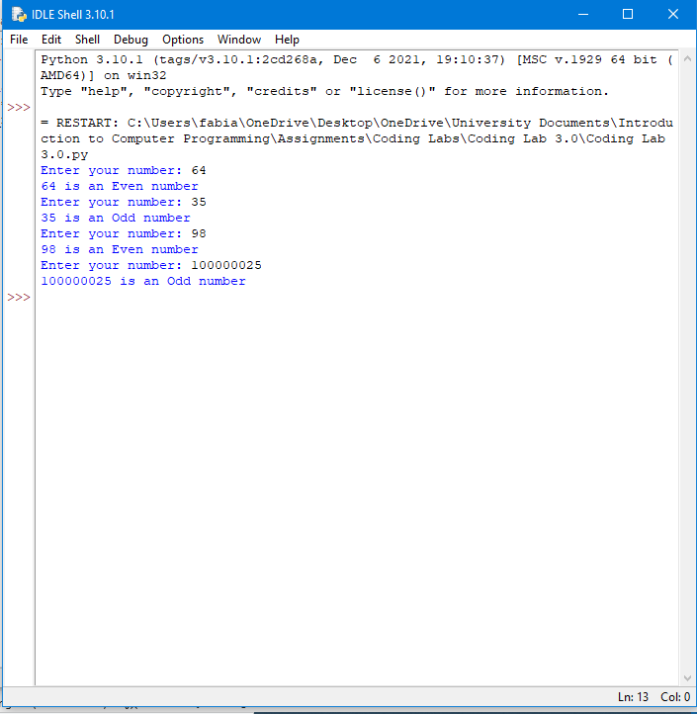
If you got no errors. Screenshot your code and the output and paste them onto this slide. If you got errors, please advance to the next slide

Slide 11
If you got errors. Screenshot your code and the error you got and paste them onto this slide.

Slide 12
What caused the error?

Slide 13
Screenshot the newly adjusted code and its output.

